Slide 1

Predicting Employee Attrition with Machine Learning
KAREEM AMEERAH

Slide 2

The Goal: Predicting Attrition Risk
1
Identify factors contributing to attrition
2
Predict whether an employee would attrit or not

Slide 3
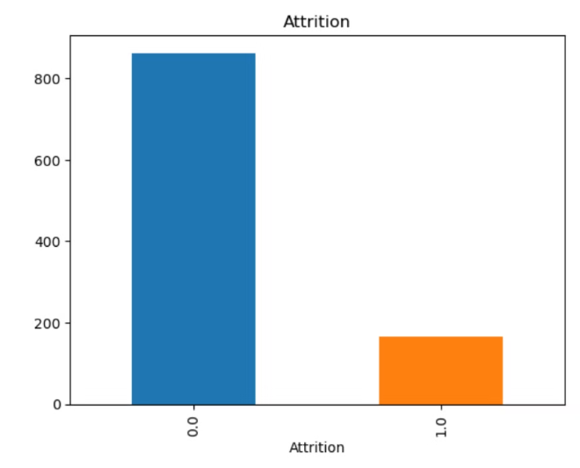
Employee Attrition
GDSC DATATHON 1.0
There are 1029 observations with 34 characteristics of employees (Features) in the training set and 330 (val set) and 1 target variable (attrition 0 for ”no” or 1 for ”yes”)
Features: ['Age', 'BusinessTravel', 'DailyRate', 'Department', 'DistanceFromHome', 'Education', 'EducationField', 'EmployeeCount', 'EmployeeNumber', 'EnvironmentSatisfaction', 'Gender', 'HourlyRate', 'JobInvolvement', 'JobLevel', 'JobRole', 'JobSatisfaction', 'MaritalStatus', 'MonthlyIncome', 'MonthlyRate', 'NumCompaniesWorked', 'Over18', 'OverTime', 'PercentSalaryHike', 'PerformanceRating', 'RelationshipSatisfaction', 'StandardHours', 'StockOptionLevel', 'TotalWorkingYears', 'TrainingTimesLastYear', 'WorkLifeBalance', 'YearsAtCompany', 'YearsInCurrentRole', 'YearsSinceLastPromotion', 'YearsWithCurrManager'].
cs

Slide 4
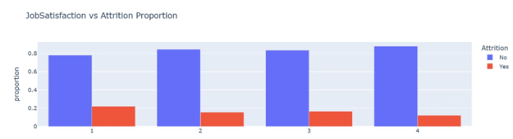
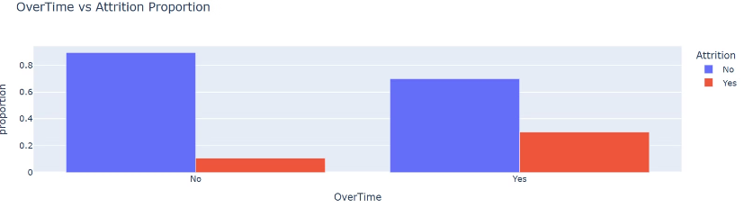
Exploratory Data Analysis
The chart suggests that employees with higher job satisfaction levels are less likely to leave the company
Overtime could be a key factor leading to attrition

Slide 5

Data Preprocessing: Transforming Raw Data for Meaningful Insights
Data Cleaning
Missing Values
Handling inconsistencies and outliers
Imputation techniques for missing data
Feature Engineering
Creating new features based on existing data

Slide 6


Models used and Performance Metric
Below 10 models have been evaluated:
The performance metrics used in the evaluation are:
Ridge Classifier
Accuracy Score: proportion of correct predictions out of the whole dataset. Be careful when the target class is imbalance, for example, if a model predicts all flight passengers as non-terrorist, then the useless model would be 99.99% accurate.
Logistic Regression
Gradient Boosting Classifier
ADA Boost Classifier
K Nearest Neighbour
Decision Tree Classifier
Recall Score: proportion of correct predictions out of all actual attrition cases.
Random Forest Classifier
Support Vector Classification (SVC)
F1 Score: optimized balance between Precision and Recall for the selected relevant target.
LGB
Linear SVC
Confusion Matrix: summarizes model performance by comparing actual and predicted values. It consists of True Positives (TP), True Negatives (TN), False Positives (FP), and False Negatives (FN), helping to evaluate accuracy, precision, recall, and overall classification performance.

Slide 7
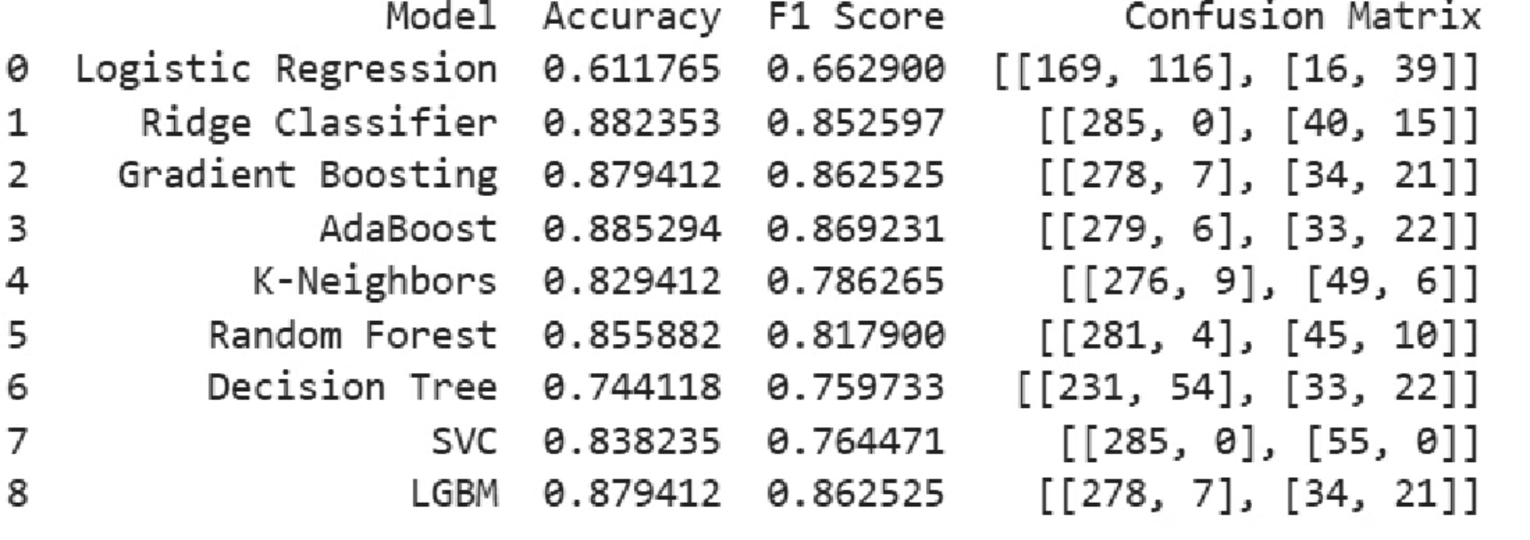
Baseline Model Performance

Slide 8
Feature Engineering
Joblevel/YAC = JobLevel / (YearsAtCompany+ 1) This is the ratio of job level to years at the company, adjusted to avoid division by zero.
Edu/Age+TotalWorking= Education/ (Age + TotalWorkingYears). This is the formal education an employee has compared to their age and work experience throughout their life.
YRSCurrMgr/YAC = YearsWithCurrManager / (YearsAtCompany+ 1). This is the consistency of an employee's relationship with their manager.
YRSCurrRole/CurrMgr = YearsInCurrentRole / (YearsWithCurrManager + 1). This is used to check how long an employee has been in their current role relative to the time they've worked under their current manager.

Slide 9
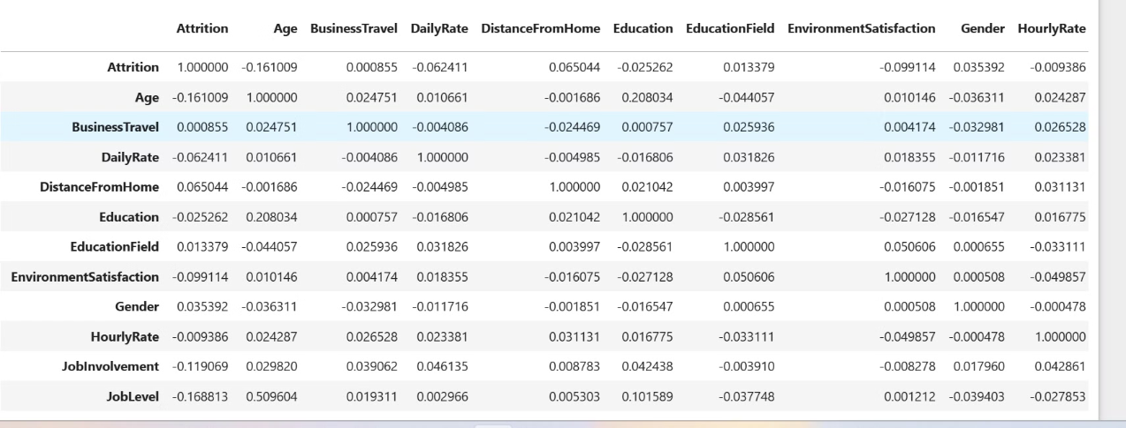
Feature Selection
Using Correlation Matrix

Slide 10
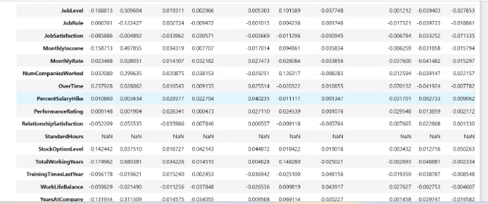
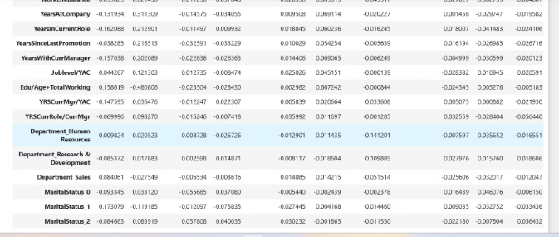
Feature Selection
Using Correlation Matrix

Slide 11
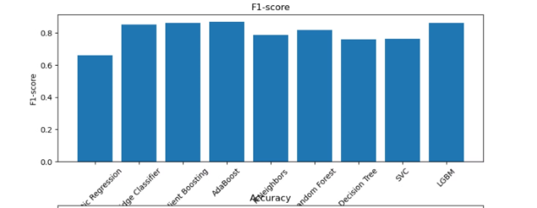
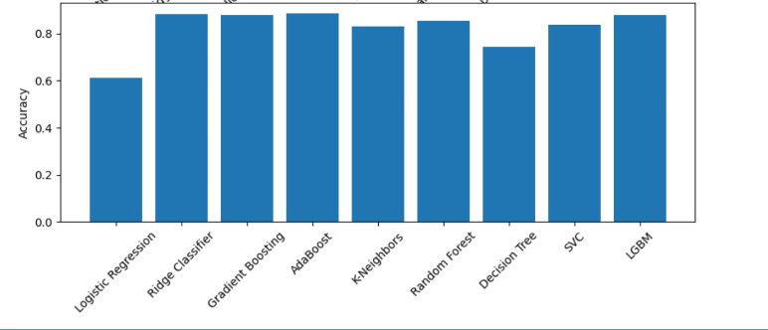
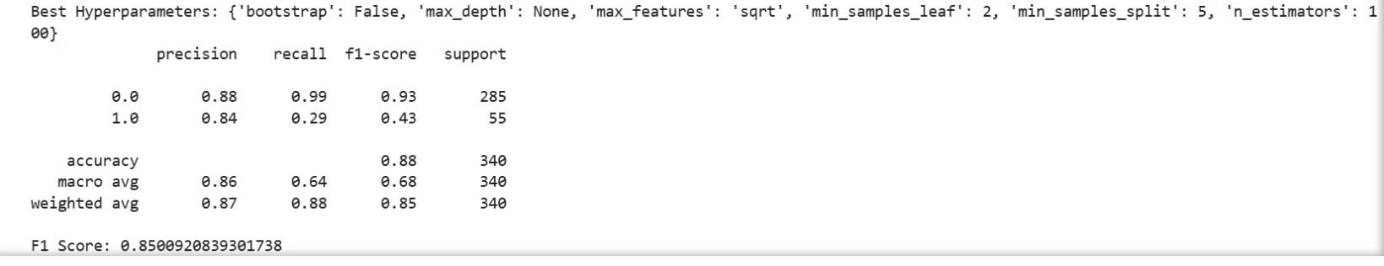
Best Performing Model Including Tuning
Best Performing Model is Random Forest

Slide 12
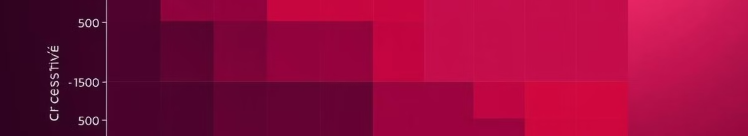
Evaluating Model Performance: Measuring Accuracy and Predictive Power
0.88%
0.85%
0.64
Accuracy
Precision
Micro Avg Recall
Overall correct predictions
Proportion of correctly predicted attrition cases
Ability to identify all attrition cases

Slide 13
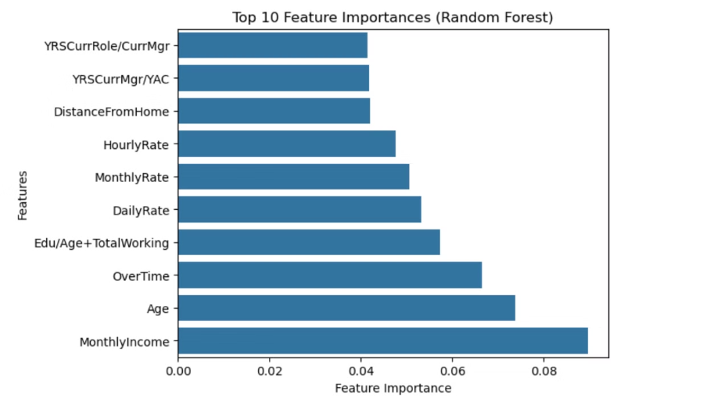
Key Findings and Future Directions
Factors Influencing Attrition
Factor 1: Monetary
Factor 2: personal Reasons
Factor 3: employee engagement

Slide 14

Kareem Ameerah

